Slide 1
Search and Rescue Assistant
Ian Davila

Slide 2
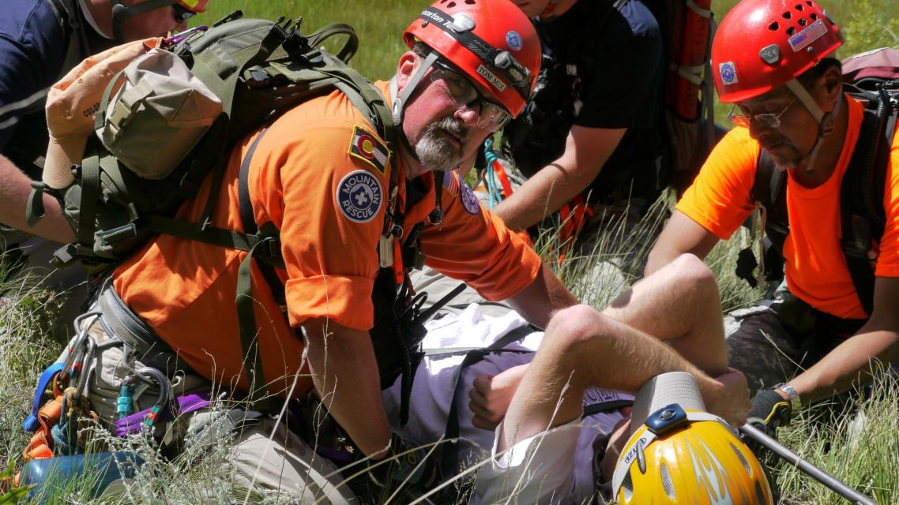
Volunteer Search and Rescue
Notes:
http://shr.elpasoco.com/sites/default/files/styles/masthead_image_-_multiple/public/resources/images/header/SAR%202011%20006.JPG?itok=VTg1efO5
Search and Rescue volunteers are vital civil servants that help find thousands of individuals every year. They are people we often don’t think about
But if you were ever to be lost out in the wilderness these are the one you can depend on to get you home safe.

Slide 3
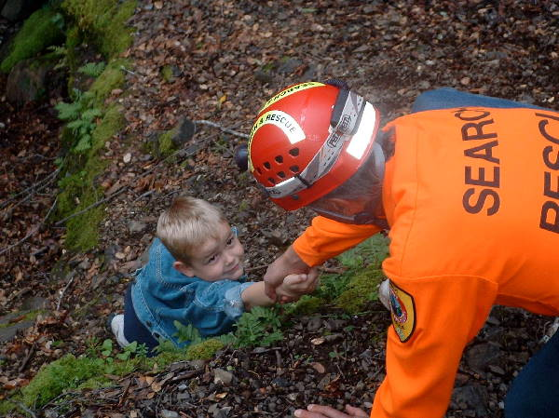
Technology problems volunteers face
Reliant on Tech
No federal/state money
Mixed equipment
Teams dependent on key personnel
Notes:
No money leads to mixed systems
Mixed systems bad because it
Causes dependencies on people
Makes it harder to perform operations with other groups
Battery problems lead to long down times/going back to camp more
Picture link
http://bvsearchandrescue.com/sites/default/files/shot0002_600.jpg
Show a picture for mixed systems, backpack with stuff on it
Picture for battery with backpack
Talk about grandpa example of using mapping program avoids costs and helps improve search and rescue opersations

Slide 4
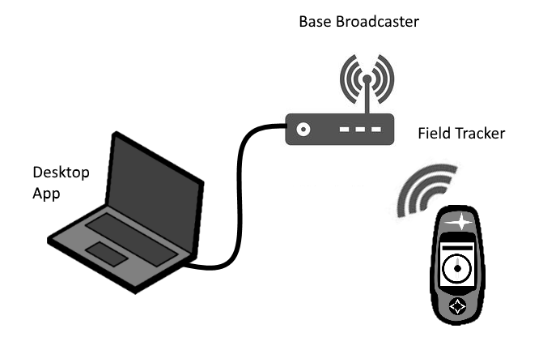
SR Assistant
Location and movement mapper
Designed Specifically for S&R
Can support large number of units
Notes:
The solution is the SR assistant.
Location and movement mapper:
-Teams take field trackers with them to search
-Every so often they perform a checking, which sends information to base broadcaster
-Broadcaster sends infor to desktop app which updates map for base commander
Designed specifically for S&R
Can support large number of units
-Other rescue groups can help
-Can expand system over time
Make it multiple slides with numbers on each,then at end, replace graphics with actual pictures of the parts

Slide 5
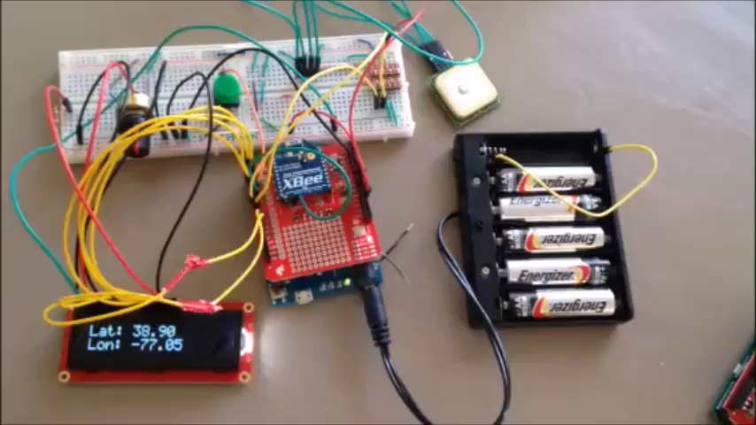
Demo
Notes:
Have video be imbedded into powerpoint slide.
Test video on a school computer
Cut demo down to 20-15 secs
Have demo with person walking around with device
Next show a graph of data for energy. Energy consumption without algor and energy with

Slide 6
Tracker
Low cost ($120-$150)
Easy to use
Long battery life
Notes:
Key to the system is the tracker
Low cost per unit, high estimates are at about 140 per unit, while the cheapest GPS is about 200$ per unit. Just as or more reliable than cheaper units
Easy to use, device will only have 1 button, so everyone will be able to use it
Long battery life means that users can be out in the field for longer periods of time. More time spent searching for individuals

Slide 7

Energy Algorithm
Keeps track of how often device is used
Manipulates components at time intervals
Constantly adapts through prolonged use
Notes:
To extend battery life, the device will monitor how often the it is used, and when it detects patterns it can then activate certain protocols
Which will either send components into a low power mode or turn them off completely.
Talk a little more about, take 2 slides
Talk about a protocol and show which parts will be turning off when Do this after describing the components

Slide 8
Effects
Standard protocol
25% Reduction in power consumption
33% extension of battery life
Irregular protocol
8% reduction in power consumption
8% extension of battery life
Notes:
Give better names

Slide 9
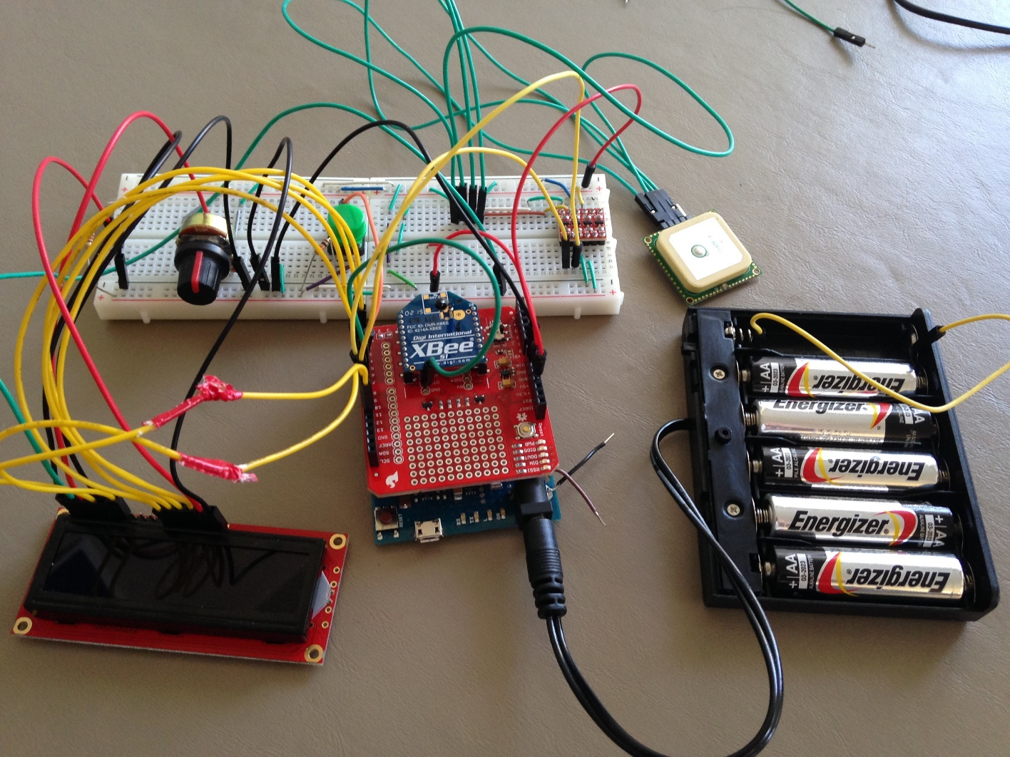
System Diagram
Notes:
Similar to the GPS, the Xbee radio communicator is given a sleep signal and it waits to be woken up by the Arduino
Quickly
Have device move and change GPS

Slide 10
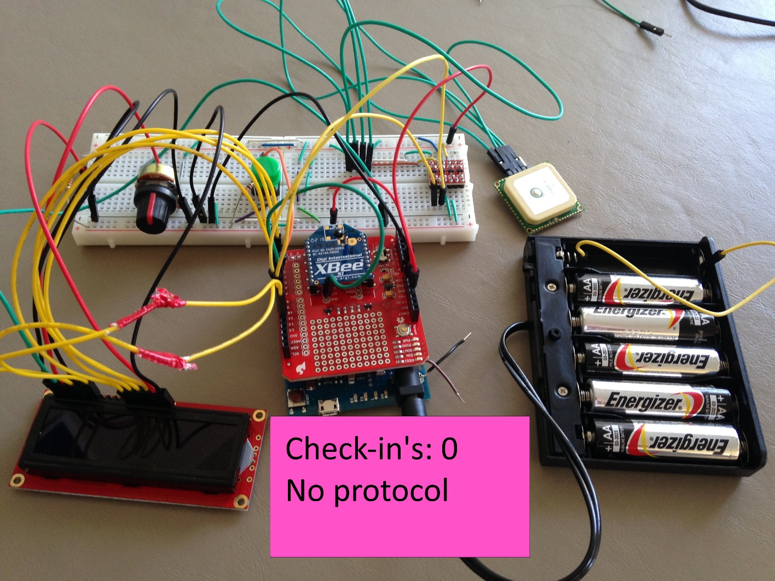
System Diagram
Notes:
Similar to the GPS, the Xbee radio communicator is given a sleep signal and it waits to be woken up by the Arduino
Quickly
Have device move and change GPS

Slide 11

System Diagram
Notes:
Similar to the GPS, the Xbee radio communicator is given a sleep signal and it waits to be woken up by the Arduino
Quickly
Have device move and change GPS

Slide 12
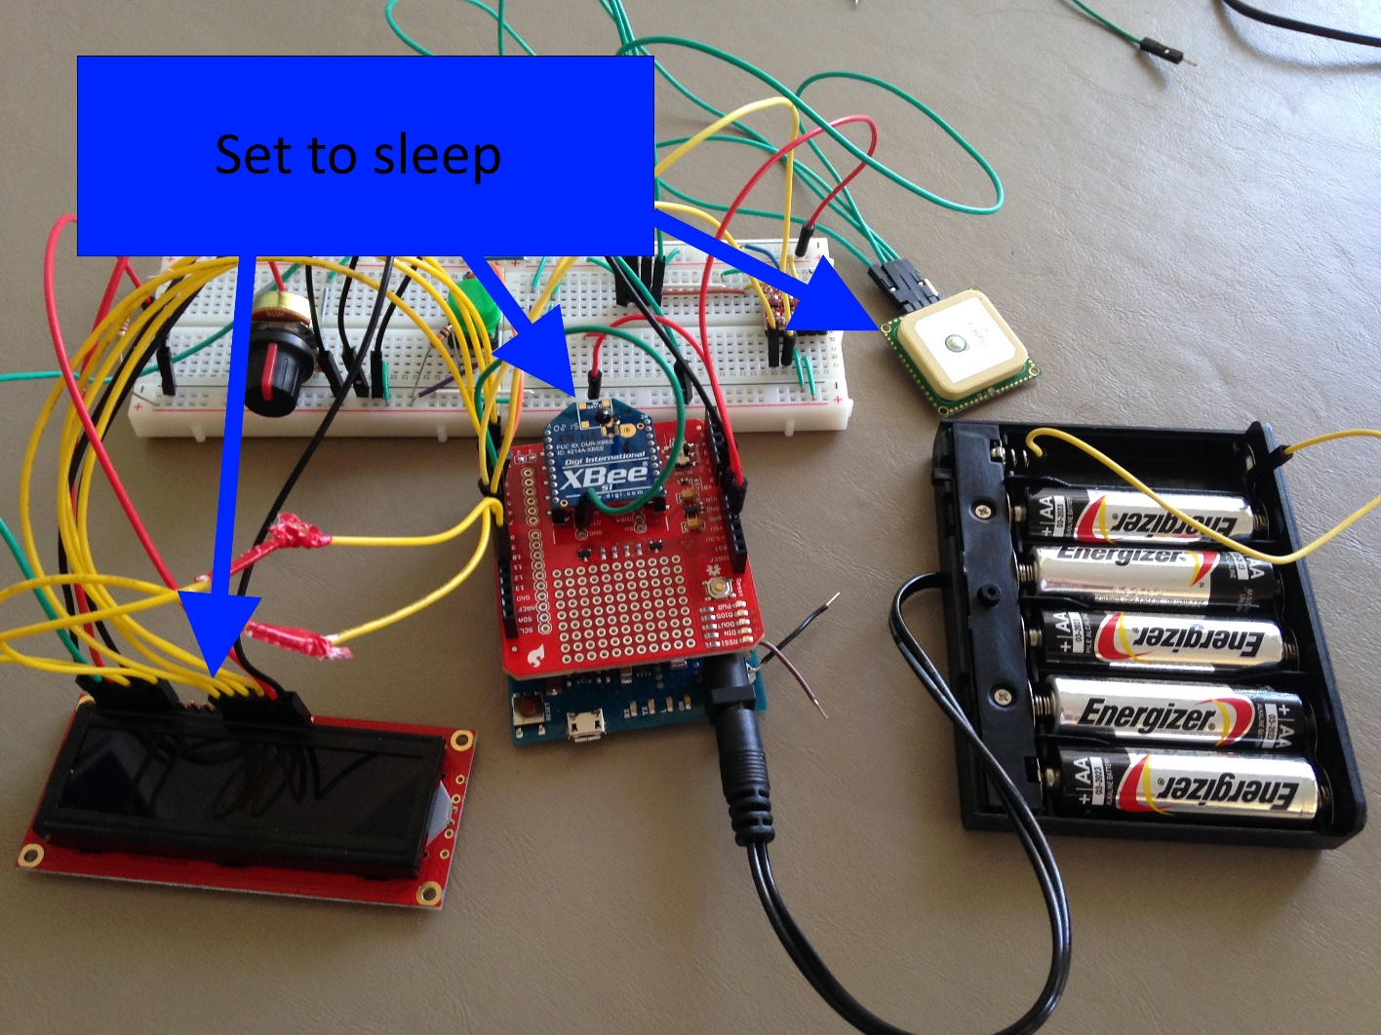
System Diagram
Notes:
Similar to the GPS, the Xbee radio communicator is given a sleep signal and it waits to be woken up by the Arduino
Quickly
Have device move and change GPS

Slide 13
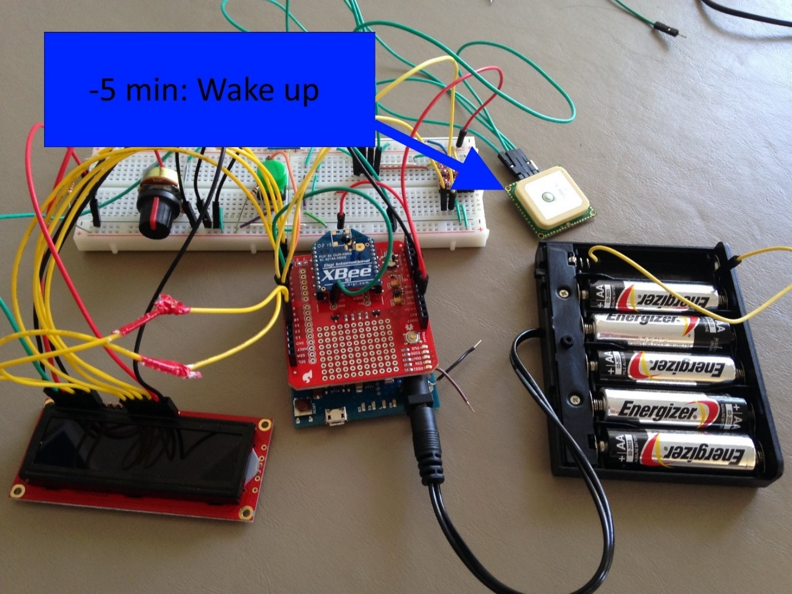
System Diagram
Notes:
Similar to the GPS, the Xbee radio communicator is given a sleep signal and it waits to be woken up by the Arduino
Quickly
Have device move and change GPS

Slide 14
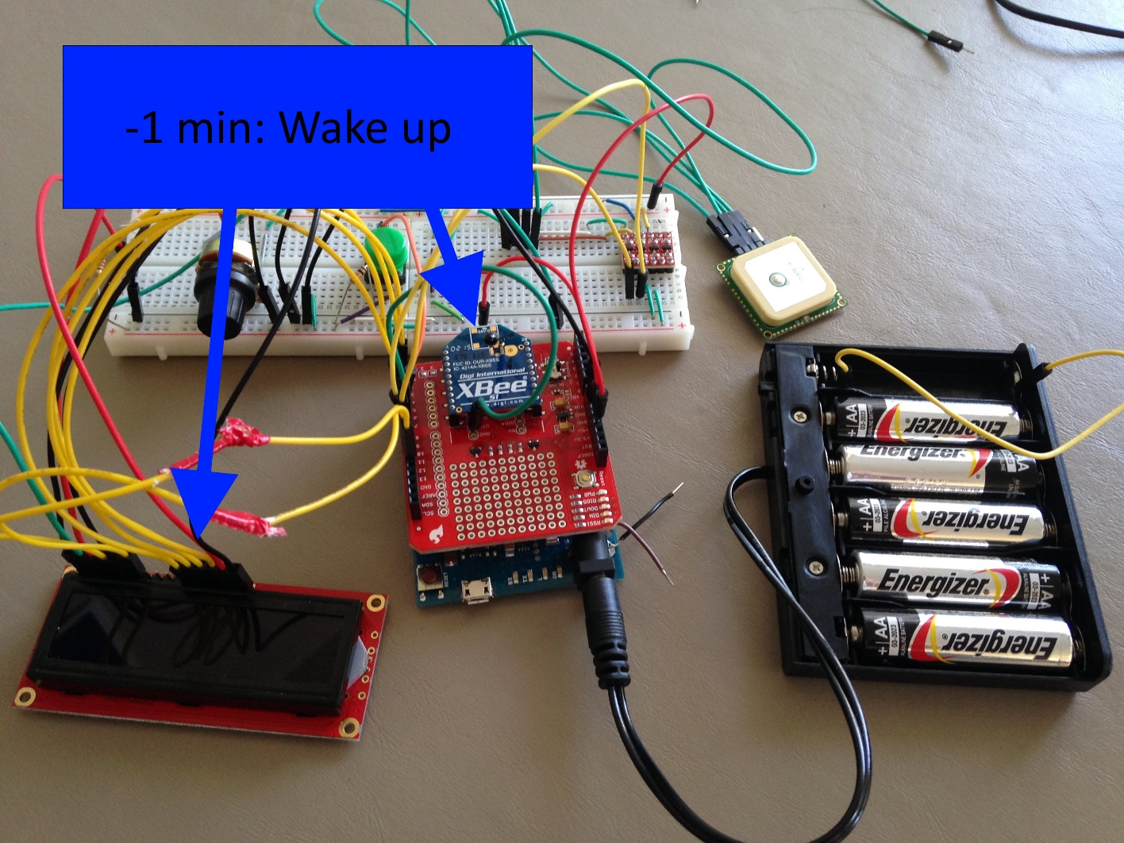
System Diagram
Notes:
Similar to the GPS, the Xbee radio communicator is given a sleep signal and it waits to be woken up by the Arduino
Quickly
Have device move and change GPS

Slide 15

System Diagram
Notes:
Similar to the GPS, the Xbee radio communicator is given a sleep signal and it waits to be woken up by the Arduino
Quickly
Have device move and change GPS

Slide 16
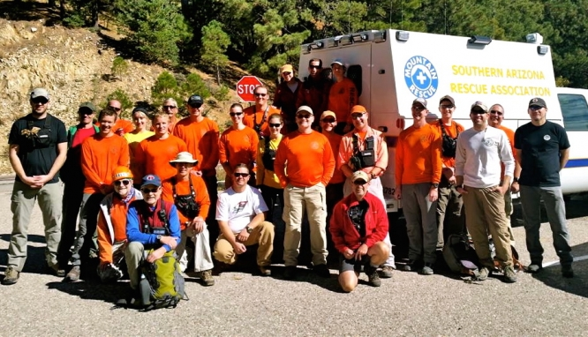
Future Plans
Field Tests
More powerful radio
Expand team
Enhance desktop application
Notes:
Really push the voice modulation here, will be very useful. Use the ending voice on the low cost and wrap it up there.
Picture source
https://uaatwork.arizona.edu/sites/default/files/styles/story-image-header-w-666px/public/images/20141101_130409.jpg
&R assistant helps eliminmate the problmes of dependency,
Hopefully in the next year or two these will be used by my grandfathers team. Thank you

